Slide 1
Phasing and Haplotype Construction
Andrew Hess
Imputation Workshop
28/9/20

Slide 2
What is a Haplotype?
Haplotype definition
A set of genes inherited together from one parent on one chromosome
All genes on a chromosome inherited together from a single parent
Inherited together because of genetic linkage
i.e. genes that are close to each other on the same chromosome tend to be inherited together.
Can also refer to variants inherited together on a chromosome, rather than genes
This workshop will focus primarily on SNPs
Resolving haplotypes i.e. Phasing
Sequencing/wet lab approaches
Computational approaches
This workshop will focus primarily on computational approaches
Aims to capture genomic segments that are the same between individuals because they are identical-by-descent (inherited from the same ancestor)

Slide 3
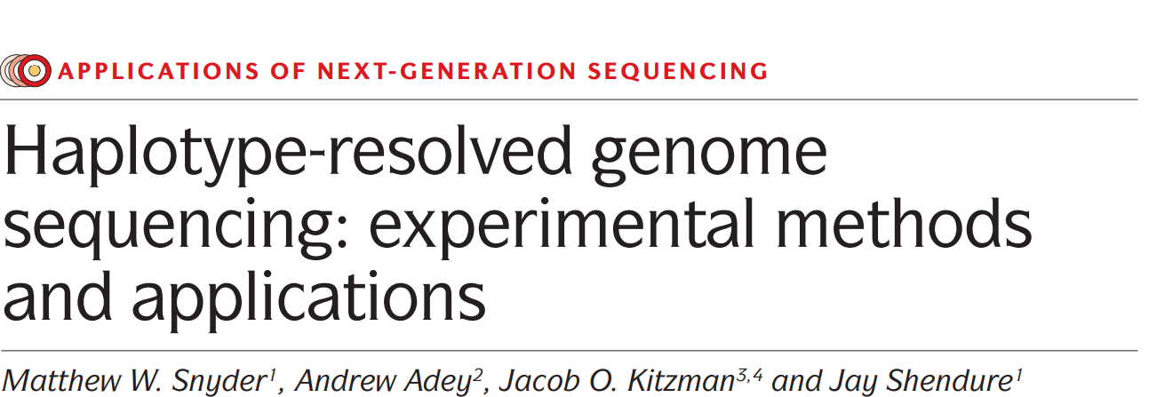
Sequencing Methods
Dense direct methods
Extensively resolve local haplotypes
Any given heterozygous variant is successfully phased with respect to the other variants in the same region
Yield haplotype blocks that are typically hundreds of kb to several Mb
Little or no experimental information relates these haplotype blocks to other blocks on the same chromosome.
Long-read sequencing, CPT-seq, Dilution pooling
Sparse direct methods
Leave many individual variants unphased but provide phase information for a subset of variants across much longer physical distances, up to entire chromosomes.
HaploSeq, Single-chromosome sequencing, Emulsion PCR

Slide 4
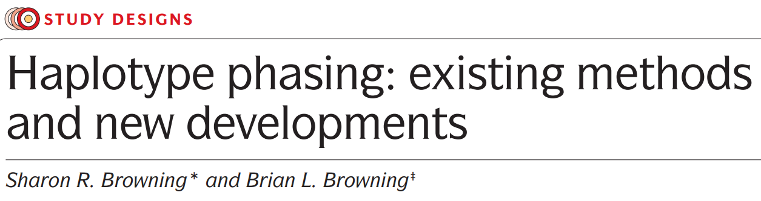
Computational Methods
“Unrelated” individuals
Use haplotypes found within the population
Very reliant on the number of individuals present
Generally: More individuals → more haplotypes observed → more accurate phasing and imputation
Do a poor job at imputing rare haplotypes/variants
Related individuals
Utilize pedigree information initially
Tracking Identity by descent (IBD)
Fill in any gaps/uncertainties using population haplotypes
Accuracy is influenced by:
a
Sample size
Marker density
Genotype accuracy
Degree of relatedness
Genetic background
Allele frequency

Slide 5
Comparison
Computational
Low cost – feasible on large number of individuals
Challenged by low-frequency variants, private variants and de novo variants
Limited by the magnitude and extent of linkage disequilibrium
Differs depending on ancestry
Pedigree-based haplotype inference requires the genotyping of multiple individuals from the same family
Sequencing
Fully resolve haplotypes for all forms of variation genome-wide using only the sample of interest
Expensive and don’t scale well
Limitations of direct methods can be partially overcome through their combined application with inferential methods.
Both
Properties of the chromosome itself
Runs of homozygosity may result in a break in the haplotype assembly
Long regions of repetitive sequence also typically result in breaks in haplotype assemblies
i.e. duplications, CNVs

Slide 6
Many programs:
Beagle
Fimpute
PHASE
Statistical Phasing
 | SNP1 | SNP2 | SNP3 | SNP4 | SNP5 | SNP6 | SNP7 | SNP8 | SNP9 | SNP10 | SNP11 | SNP12 | SNP13 | SNP14 | SNP15 | SNP16
Ind1 | 1 | 1 | 1 | 1 | 2 | 2 | 2 | 0 | 0 | 2 | 1 | 1 | 2 | 2 | 2 | 0
Ind2 | 1 | 1 | 2 | 1 | 2 | 1 | 2 | 0 | 0 | 2 | 1 | 1 | 1 | 2 | 1 | 1
Ind3 | 1 | 1 | 2 | 0 | 2 | 2 | 1 | 0 | 1 | 2 | 2 | 1 | 2 | 2 | 2 | 0
Ind4 | 2 | 2 | 2 | 1 | 1 | 1 | 1 | 0 | 1 | 2 | 1 | 0 | 1 | 2 | 1 | 1
Ind5 | 1 | 1 | 1 | 0 | 1 | 2 | 1 | 0 | 1 | 2 | 2 | 1 | 2 | 2 | 2 | 0
Downstream Analysis
Haplotype Diversity
Haplotype GWAS
Etc
 | SNP1 | SNP2 | SNP3 | SNP4 | SNP5 | SNP6 | SNP7 | SNP8 | SNP9 | SNP10 | SNP11 | SNP12 | SNP13 | SNP14 | SNP15 | SNP16
Ind1_M | 0 | 0 | 0 | 0 | 1 | 1 | 1 | 0 | 0 | 1 | 1 | 1 | 1 | 1 | 1 | 0
Ind1_P | 1 | 1 | 1 | 1 | 1 | 1 | 1 | 0 | 0 | 1 | 0 | 0 | 1 | 1 | 1 | 0
Ind2_M | 1 | 1 | 1 | 1 | 1 | 0 | 1 | 0 | 0 | 1 | 0 | 0 | 0 | 1 | 0 | 1
Ind2_P | 0 | 0 | 1 | 0 | 1 | 1 | 1 | 0 | 0 | 1 | 1 | 1 | 1 | 1 | 1 | 0
Ind3_M | 1 | 1 | 1 | 0 | 1 | 1 | 0 | 0 | 1 | 1 | 1 | 0 | 1 | 1 | 1 | 0
Ind3_P | 0 | 0 | 1 | 0 | 1 | 1 | 1 | 0 | 0 | 1 | 1 | 1 | 1 | 1 | 1 | 0
Ind4_M | 1 | 1 | 1 | 1 | 1 | 0 | 1 | 0 | 0 | 1 | 0 | 0 | 0 | 1 | 0 | 1
Ind4_P | 1 | 1 | 1 | 0 | 0 | 1 | 0 | 0 | 1 | 1 | 1 | 0 | 1 | 1 | 1 | 0
Ind5_M | 0 | 0 | 0 | 0 | 1 | 1 | 1 | 0 | 0 | 1 | 1 | 1 | 1 | 1 | 1 | 0
Ind5_P | 1 | 1 | 1 | 0 | 0 | 1 | 0 | 0 | 1 | 1 | 1 | 0 | 1 | 1 | 1 | 0
Based on:
Number of SNPs
Location
LD/Recombination
 | Haplock1 |  |  |  | Haploblock2 |  |  |  | Haploblock3 |  |  |  | Haploblock4
Ind1_M | 0 | 0 | 0 | 0 | 1 | 1 | 1 | 0 | 0 | 1 | 1 | 1 | 1 | 1 | 1 | 0
Ind1_P | 1 | 1 | 1 | 1 | 1 | 1 | 1 | 0 | 0 | 1 | 0 | 0 | 1 | 1 | 1 | 0
Ind2_M | 1 | 1 | 1 | 1 | 1 | 0 | 1 | 0 | 0 | 1 | 0 | 0 | 0 | 1 | 0 | 1
Ind2_P | 0 | 0 | 1 | 0 | 1 | 1 | 1 | 0 | 0 | 1 | 1 | 1 | 1 | 1 | 1 | 0
Ind3_M | 1 | 1 | 1 | 0 | 1 | 1 | 0 | 0 | 1 | 1 | 1 | 0 | 1 | 1 | 1 | 0
Ind3_P | 0 | 0 | 1 | 0 | 1 | 1 | 1 | 0 | 0 | 1 | 1 | 1 | 1 | 1 | 1 | 0
Ind4_M | 1 | 1 | 1 | 1 | 1 | 0 | 1 | 0 | 0 | 1 | 0 | 0 | 0 | 1 | 0 | 1
Ind4_P | 1 | 1 | 1 | 0 | 0 | 1 | 0 | 0 | 1 | 1 | 1 | 0 | 1 | 1 | 1 | 0
Ind5_M | 0 | 0 | 0 | 0 | 1 | 1 | 1 | 0 | 0 | 1 | 1 | 1 | 1 | 1 | 1 | 0
Ind5_P | 1 | 1 | 1 | 0 | 0 | 1 | 0 | 0 | 1 | 1 | 1 | 0 | 1 | 1 | 1 | 0
 | HB1 | HB2 | HB3 | HB4
Ind1_M | A | A | A | A
Ind1_P | B | A | B | A
Ind2_M | B | B | B | B
Ind2_P | C | A | A | A
Ind3_M | D | C | C | A
Ind3_P | C | A | A | A
Ind4_M | B | B | B | B
Ind4_P | D | D | C | A
Ind5_M | A | A | A | A
Ind5_P | D | D | C | A

Slide 7
Imputation
 | SNP1 | SNP2 | SNP3 | SNP4 | SNP5 | SNP6 | SNP7 | SNP8 | SNP9 | SNP10 | SNP11 | SNP12 | SNP13 | SNP14 | SNP15 | SNP16
Ind1_M | 0 | 0 | 0 | 0 | 1 | 1 | 1 | 0 | 0 | 1 | 1 | 1 | 1 | 1 | 1 | 0
Ind1_P | 1 | 1 | 1 | 1 | 1 | 1 | 1 | 0 | 0 | 1 | 0 | 0 | 1 | 1 | 1 | 0
Ind2_M | 1 | 1 | 1 | 1 | 1 | 0 | 1 | 0 | 0 | 1 | 0 | 0 | 0 | 1 | 0 | 1
Ind2_P | 0 | 0 | 1 | 0 | 1 | 1 | 1 | 0 | 0 | 1 | 1 | 1 | 1 | 1 | 1 | 0
Ind3_M | 1 | 1 | 1 | 0 | 1 | 1 | 0 | 0 | 1 | 1 | 1 | 0 | 1 | 1 | 1 | 0
Ind3_P | 0 | 0 | 1 | 0 | 1 | 1 | 1 | 0 | 0 | 1 | 1 | 1 | 1 | 1 | 1 | 0
Ind4_M | 1 | 1 | 1 | 1 | 1 | 0 | 1 | 0 | 0 | 1 | 0 | 0 | 0 | 1 | 0 | 1
Ind4_P | 1 | 1 | 1 | 0 | 0 | 1 | 0 | 0 | 1 | 1 | 1 | 0 | 1 | 1 | 1 | 0
Ind5_M | 0 | 0 | 0 | 0 | 1 | 1 | 1 | 0 | 0 | 1 | 1 | 1 | 1 | 1 | 1 | 0
Ind5_P | 1 | 1 | 1 | 0 | 0 | 1 | 0 | 0 | 1 | 1 | 1 | 0 | 1 | 1 | 1 | 0
Reference Haplotypes
 | SNP1 | SNP2 | SNP3 | SNP4 | SNP5 | SNP6 | SNP7 | SNP8 | SNP9 | SNP10 | SNP11 | SNP12 | SNP13 | SNP14 | SNP15 | SNP16
Ind6 | 1 | ? | ? | ? | 2 | ? | 2 | ? | 0 | 2 | 2 | ? | ? | 2 | ? | 0
Ind7 | 2 | ? | ? | ? | 2 | ? | 2 | ? | 1 | 2 | 1 | ? | ? | 2 | ? | 0
Ind8 | 1 | ? | ? | ? | 0 | ? | 0 | ? | 2 | 2 | 2 | ? | ? | 2 | ? | 0
Low-Density Genotypes
 | SNP1 | SNP2 | SNP3 | SNP4 | SNP5 | SNP6 | SNP7 | SNP8 | SNP9 | SNP10 | SNP11 | SNP12 | SNP13 | SNP14 | SNP15 | SNP16
Ind6_M | 0 | ? | ? | ? | 1 | ? | 1 | ? | 0 | 1 | 1 | ? | ? | 1 | ? | 0
Ind6_P | 1 | ? | ? | ? | 1 | ? | 1 | ? | 0 | 1 | 1 | ? | ? | 1 | ? | 0
Ind7_M | 1 | ? | ? | ? | 1 | ? | 1 | ? | 0 | 1 | 0 | ? | ? | 1 | ? | 0
Ind7_P | 1 | ? | ? | ? | 1 | ? | 1 | ? | 1 | 1 | 1 | ? | ? | 1 | ? | 0
Ind8_M | 1 | ? | ? | ? | 0 | ? | 0 | ? | 1 | 1 | 1 | ? | ? | 1 | ? | 0
Ind8_P | 0 | ? | ? | ? | 0 | ? | 0 | ? | 1 | 1 | 1 | ? | ? | 1 | ? | 0
Haplotypes as a mosaic
of reference
 | SNP1 | SNP2 | SNP3 | SNP4 | SNP5 | SNP6 | SNP7 | SNP8 | SNP9 | SNP10 | SNP11 | SNP12 | SNP13 | SNP14 | SNP15 | SNP16
Ind6 | 1 | 1 | 1 | 1 | 2 | 2 | 2 | 0 | 0 | 2 | 2 | 0 | 2 | 2 | 2 | 0
Ind7 | 2 | 2 | 2 | 2 | 2 | 1 | 2 | 0 | 1 | 2 | 1 | 1 | 2 | 2 | 2 | 0
Ind8 | 1 | 2 | 2 | 0 | 0 | 2 | 0 | 0 | 2 | 2 | 2 | 1 | 2 | 2 | 2 | 0
Inferred Genotypes

Slide 8
Comparison: https://www.ncbi.nlm.nih.gov/pmc/articles/PMC6142395/
Programs Available: HMM
Beagle (http://faculty.washington.edu/browning/beagle/beagle.html)
Beagle 4.0
Can use genotype likelihoods as input
Allows use of pedigree information
Beagle 5.0
Substantially faster and more accurate than 4.0
Can accommodate multiallelic markers
SHAPEIT
SHAPEIT2 (https://mathgen.stats.ox.ac.uk/genetics_software/shapeit/shapeit.html)
Integrate sequence and array data
SHAPEIT4 (https://github.com/odelaneau/shapeit4)
Integrates multiple sources of information
Externally phased reference panels
Collections of pre-phased genotypes
Long-read sequence data

Slide 9
Programs Available: Rule-Based
Fimpute
Academic licence available upon request
Uses pedigree information
Fills in the remaining missing information using a window-based approach
Fast and less memory intensive method for phasing
AlphaImpute (https://alphagenes.roslin.ed.ac.uk/wp/software-2/alphaimpute/)
Uses pedigree
Heuristic method
basic rules of Mendelian inheritance
segregation analysis
long-range phasing
haplotype library imputation
NEW: AlphaImpute2
Combines pedigree and HMM methods for fast and accurate algorithm

Slide 10
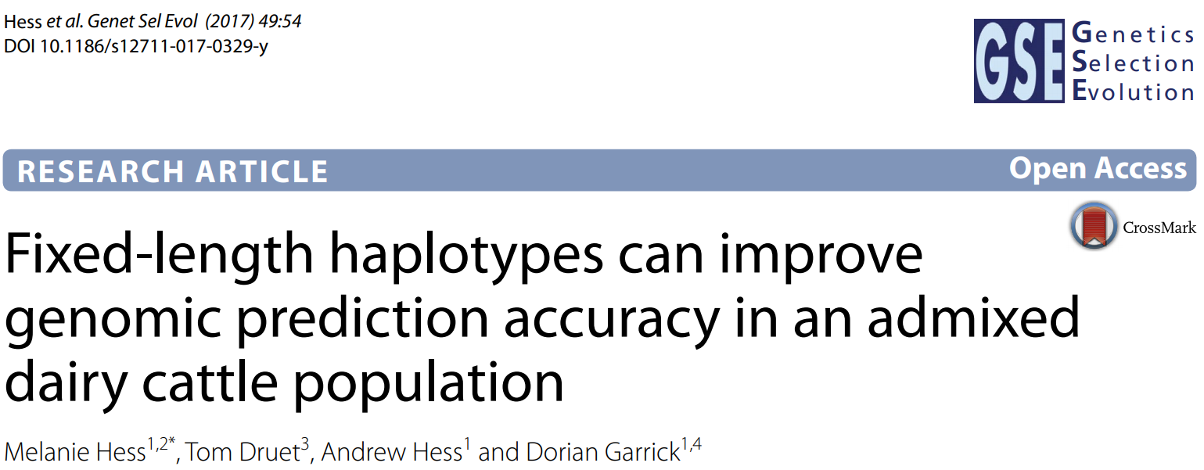
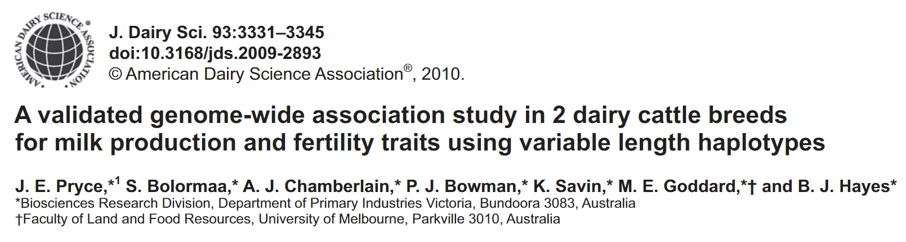
The haplotype method improves the power to detect QTL as demonstrated by
reduced FDR in the discovery data set
greater proportion of validated associations
shorter genomic regions containing QTL
detection of a putative QTL for fertility that was not detected by single SNP associations
Fitting haplotype alleles rather than SNPs can increase prediction accuracy
Improved genomic prediction accuracy with comparable computation time to fitting SNPs
Increased accuracy is likely to increase genetic gain by changing the ranking of selection candidates

Slide 11
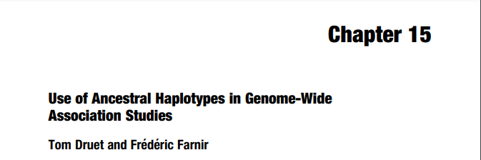
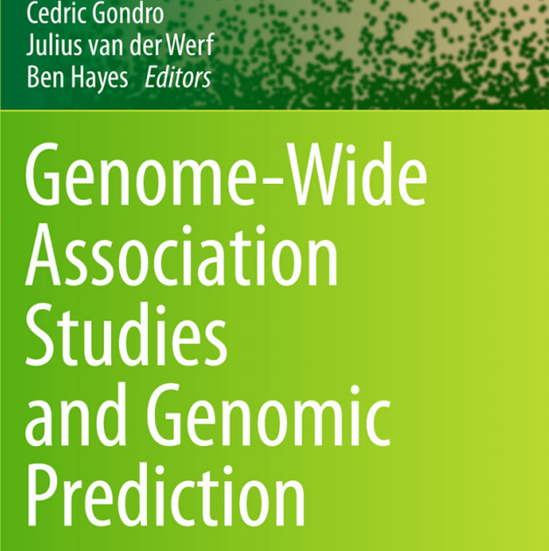
Applications: GWAS
Overview of HMM for phasing
Discusses use of ancestral haplotype states for GWAS
Multiple examples, one being (https://www.genetics.org/content/184/3/789)
PHASEBOOK
Efficient heuristic approach based on hidden Markov models (HMM)
It simultaneously phases and sorts haplotypes in clusters that can be used directly for mapping or other purposes
Exploits familial as well as population information

Slide 12
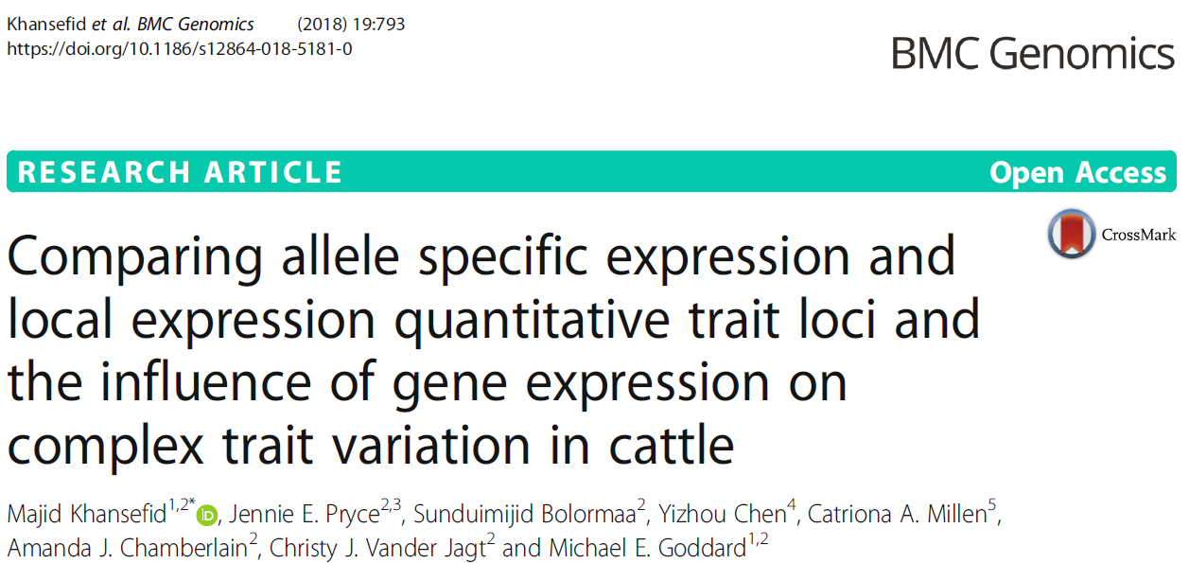
Application: Genetical Genomics
Expression Data (https://link.springer.com/article/10.1186/s12864-018-5181-0)
Association of particular variant with expression differences (eQTL) – tracking alleles allows detection of alleles allows association of specific alleles with gene expression
Identifying paternally/maternally inherited haplotypes allows for detection of whether there is a SNP that alters gene expression a Parent-of-Origin manner (i.e. whether the locus is expected to be imprinted).
Can also be used with phenotypes (https://www.sciencedirect.com/science/article/pii/S0002929715003213)
Detect loci where, e.g. disease outcome, is dependent on which parent the genetic variant is inherited from.

Slide 13
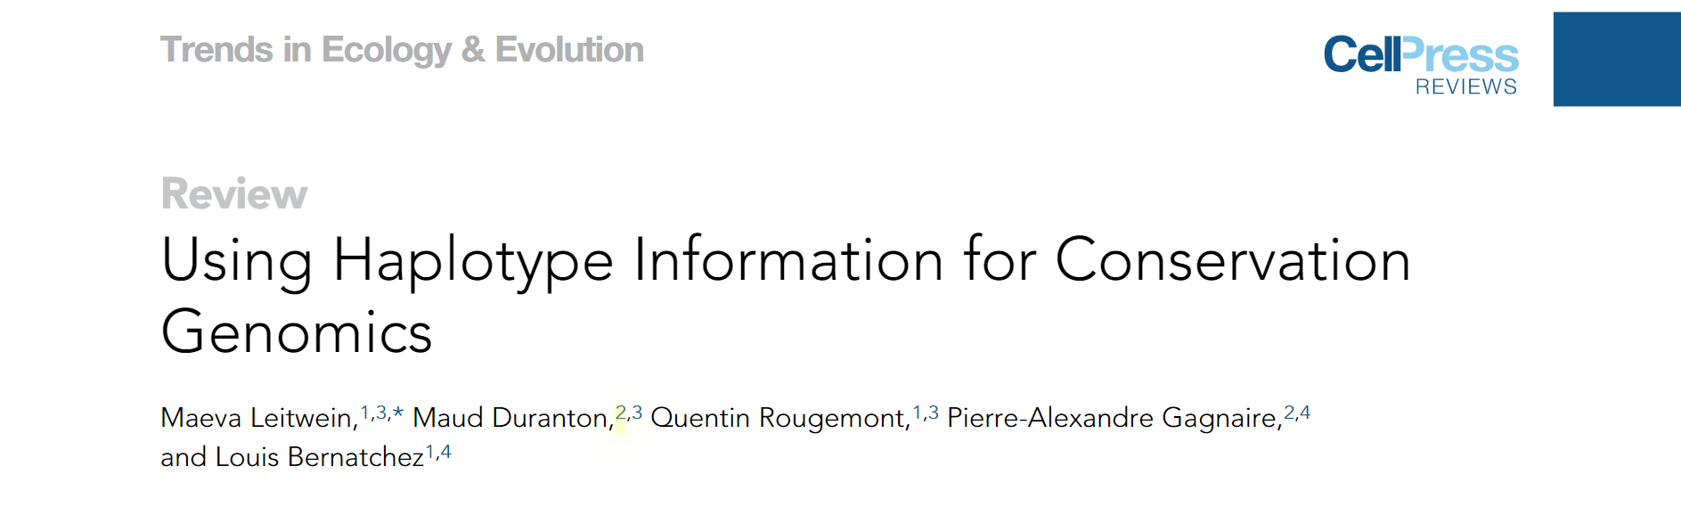
Application: Conservation Genomics
Using haplotype information can improve the inference of population demographic parameters including effective population size and migration
Tracked by IBD segments
Can be used for local ancestry inference/admixture
More accurate identification of selection sweeps

Slide 14

Considerations for Experimental Design
How many individuals?
What is the minimum number of individuals needed to capture the diversity in the population?
How many are needed for a “core” set of individuals
Which individuals?
Which animals should be selected to maximize the information captured?
Individuals to capture a higher density/depth
Value of Resources Already Available?
How representative are the resources already available?
Is there value in capturing more than what is already available?

Slide 15
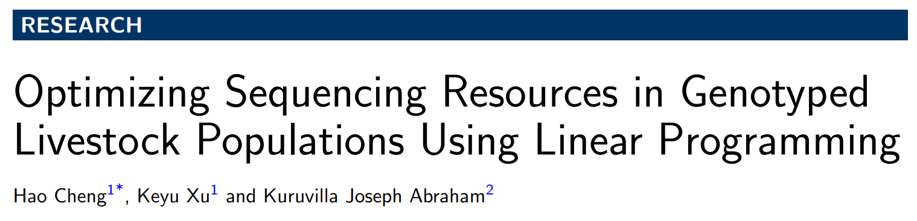
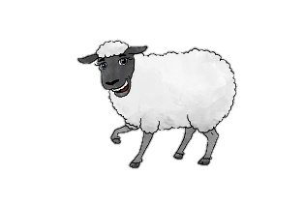

LPChoose
Linear programming algorithm for allocation of sequencing resources across animals in a population
Sequencing is costly; therefore it is usually not feasible to sequence all animals
Which animals do we need to sequence to:
Capture all haplotypes in the population with the least animals sequenced?
Maximise the number of haplotypes captured for a given number of animals sequenced?
I choose…
That one!

Slide 16
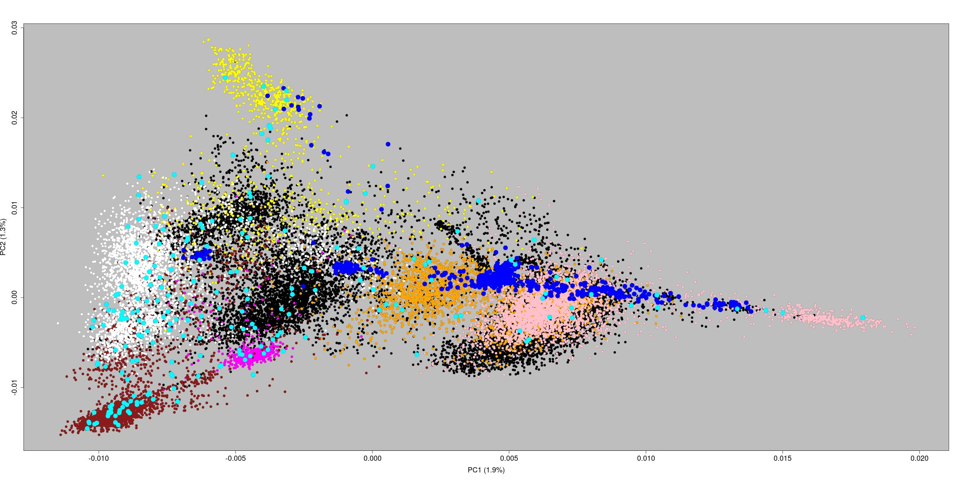
Based on HD Genotypes
Texel
Cyan: NZ WGS
Blue: Other WGS
Highlander
Coopworth
Primera
Perendale
Romney

Slide 17
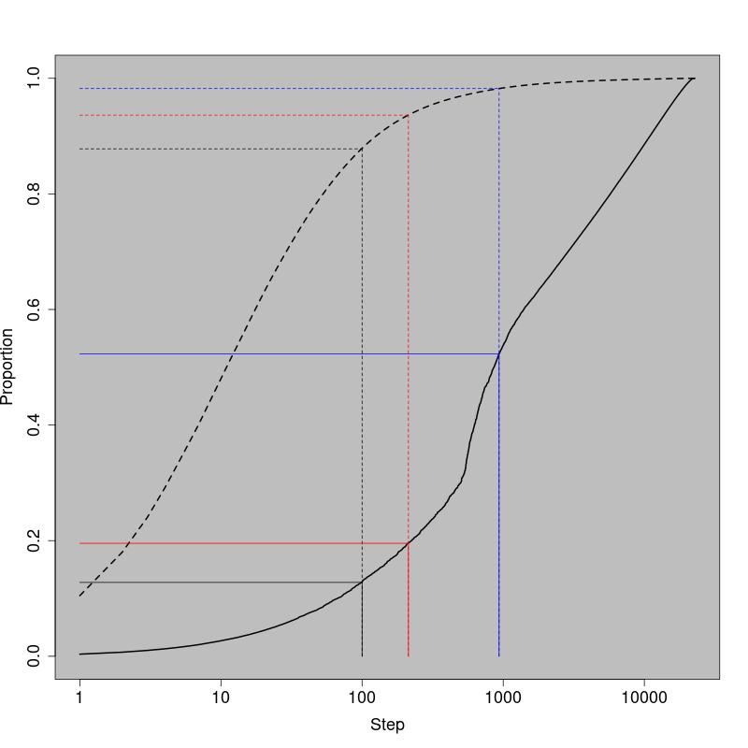
Solid Line: Haplotypes Dashed Line: Individuals
0.982
0.937
How many animals
to choose?
0.879
Frequent haplotypes get captured quickly
Many animals have at least one low-frequency haplotype
22,765 of 22,887 to capture all present
How quickly haplotypes are captured depends on definition
0.524
0.196
0.128
Based on HD Genotypes
Haploblock: 250 Kb

Slide 18
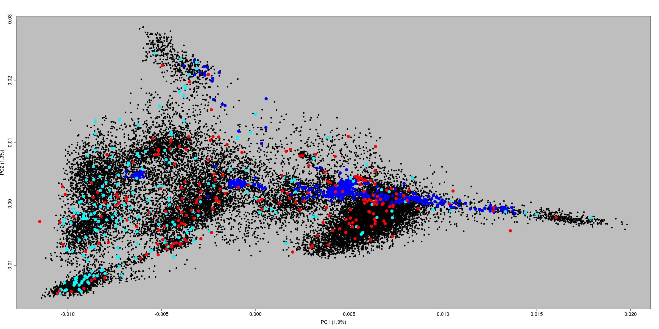
Based on HD Genotypes
Animals selected by LPChoose more in the centre of the plot
Crossbreds
More individuals on the right side of the plot
Reflective of individuals available at time of selection
Cyan: NZ WGS
Blue: Other WGS
Red: LPChoose

Slide 19
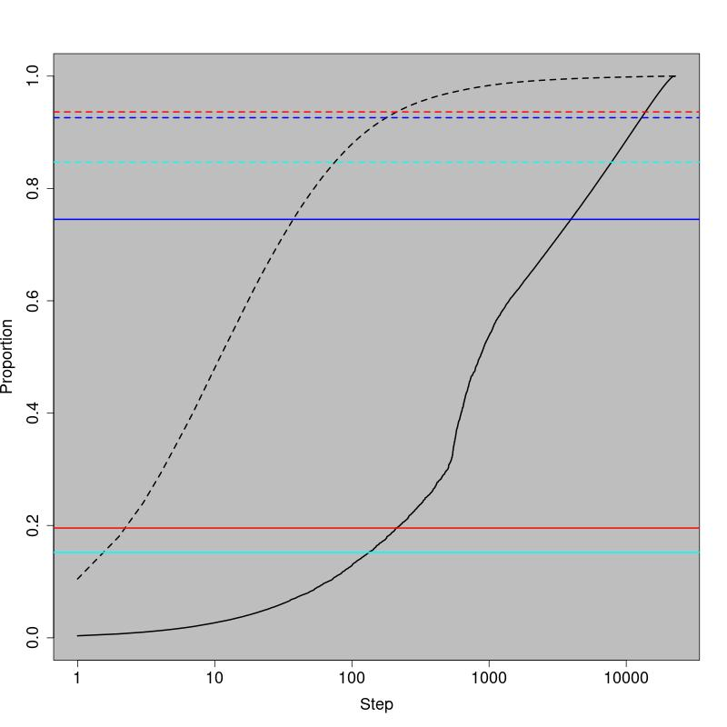
213 LPChoose: 0.937
How well do the animals with WGS data do?
935 WGS: 0.926
213 NZ WGS: 0.847
935 WGS: 0.745
Most of the haplotypes are covered in the WGS set
NZ animals captured more unique haplotypes than 213 chosen by LPChoose
Inclusion of non-NZ animals results in more NZ haplotypes being covered
213 LPChoose: 0.196
213 NZ WGS: 0.152
Based on HD Genotypes
Haploblock: 250 Kb

Slide 20
 | SNP1 | SNP2 | SNP3 | SNP4 | SNP5 | SNP6 | SNP7 | SNP8 | SNP9 | SNP10 | SNP11 | SNP12 | SNP13 | SNP14 | SNP15 | SNP16
Ind6 | 1 | ? | ? | ? | 2 | ? | 2 | ? | 0 | 2 | 2 | ? | ? | 2 | ? | 0
Ind7 | 2 | ? | ? | ? | 2 | ? | 2 | ? | 1 | 2 | 1 | ? | ? | 2 | ? | 0
Ind8 | 1 | ? | ? | ? | 0 | ? | 0 | ? | 2 | 2 | 2 | ? | ? | 2 | ? | 0
Imputation from
HD to WGS
 | SNP1 | SNP2 | SNP3 | SNP4 | SNP5 | SNP6 | SNP7 | SNP8 | SNP9 | SNP10 | SNP11 | SNP12 | SNP13 | SNP14 | SNP15 | SNP16
Ind6 | 1 | 1 | 1 | 1 | 2 | 2 | 2 | 0 | 0 | 2 | 2 | 0 | 2 | 2 | 2 | 0
Ind7 | 2 | 2 | 2 | 2 | 2 | 1 | 2 | 0 | 1 | 2 | 1 | 1 | 2 | 2 | 2 | 0
Ind8 | 1 | 2 | 2 | 0 | 0 | 2 | 0 | 0 | 2 | 2 | 2 | 1 | 2 | 2 | 2 | 0
Phasing/Imputation in Beagle 5.1
Default parameters except N_{e}=500
Masked 759 Chromosome 26 SNPs in HD animals
Imputed to 505,190 WGS SNPs
Individual accuracy as concordance between true and imputed genotype across all masked SNPs
Imputation Accuracy (HD→WGS): 0.965
Filtered based on MAF (0.01)/Callrate (0.99) in NZ WGS animals (280,750 SNPs)
NZ WGS Animals as reference: 0.958
NZ and AUS WGS Animals as reference: 0.969
All WGS Animals as reference: 0.972

Slide 21
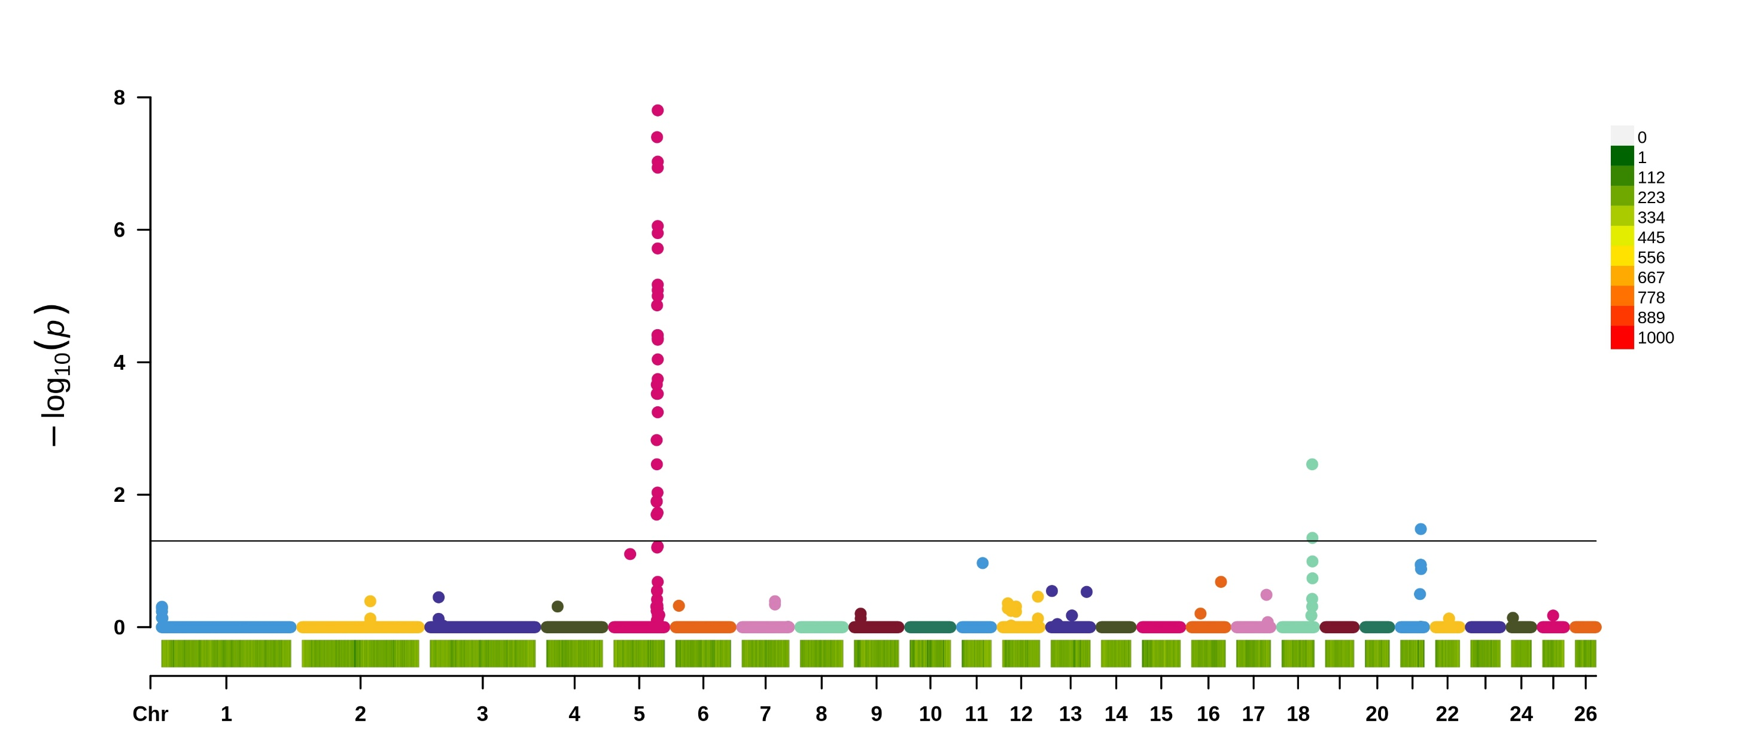
N=10,146
h²=0.27 ± 0.02
Measured by shear force
FDR Control: Benjamini-Yekutieli
Tenderness-HD
CAST
DLK1
CAPN1

Slide 22
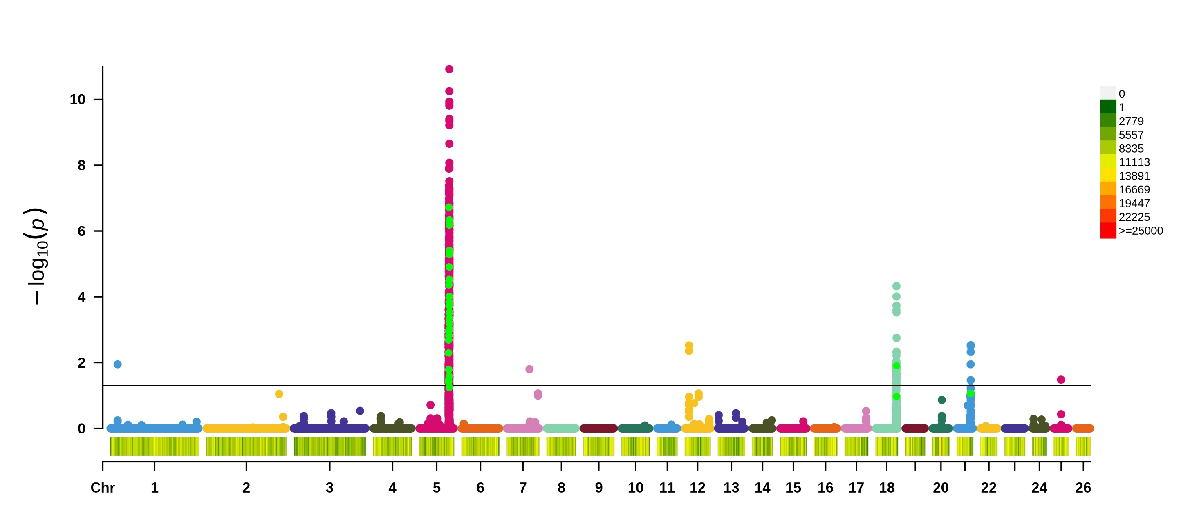
N=10,146
h²=0.27 ± 0.02
Measured by shear force
FDR Control: Benjamini-Yekutieli
Tenderness-WGS
CAST
DLK1
CAPN1
BRINP3
SIX1
CTNNA3
?

Slide 23
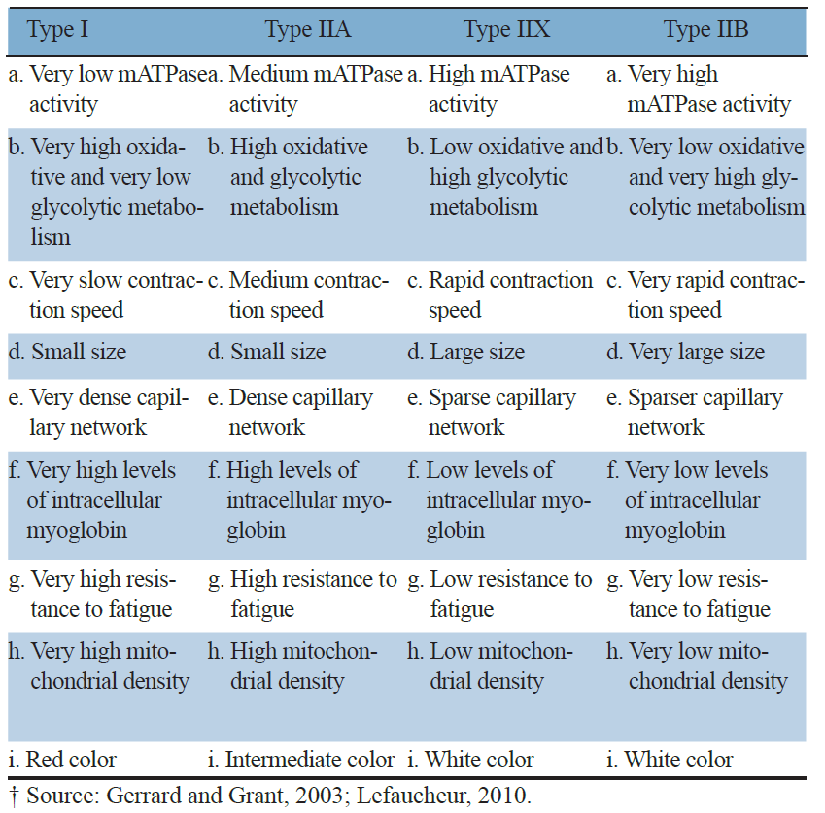
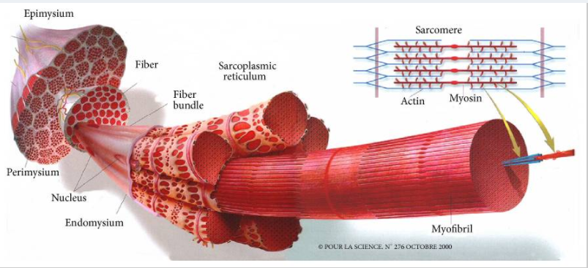
Link between Muscle Fibre Types and Meat Tenderness
https://www.ncbi.nlm.nih.gov/pmc/articles/PMC4789028/
doi:10.2527/af.2017.0437

Slide 24
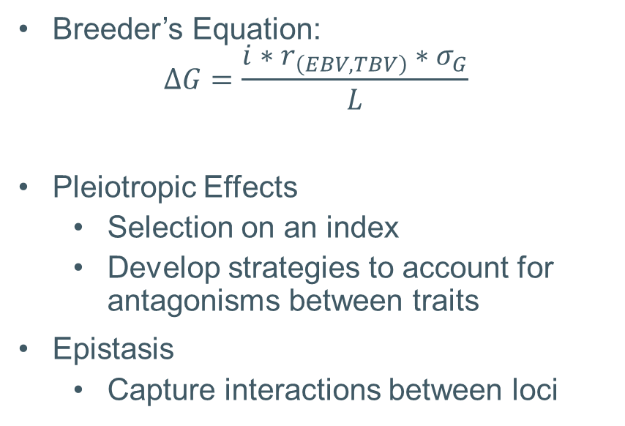
h²=0.27 ± 0.02
Use in Genomic Prediction
Forward prediction:
Train 2010-2014 (n=9,361)
Validate 2015 (n=785)
Single GRM
HD
HD+WGS
WGS: All SNPs surpassed FDR adjusted p-value (0.05)
Two GRM
Relationship matrix for HD and WGS SNPs separately
Allows large effects to remain large
Breeder’s Equation:
$$∆G=\frac{i∗r_{\left(EBV,TBV\right)}∗σ_{G}}{L}$$
Pleiotropic Effects
Selection on an index
Develop strategies to account for antagonisms between traits
Epistasis
Capture interactions between loci
 | HD | HD+WGS
r_{(EBV,Phenotype)} | 0.179 | 0.197
r_{(EBV,TBV)} | 0.345 | 0.373
 | HD | HD+WGS | HD+WGS (2GRM)
r_{(EBV,Phenotype)} | 0.179 | 0.197 | 0.243
r_{(EBV,TBV)} | 0.345 | 0.373 | 0.424
8%
23%

Slide 25
Summary
Haplotypes can be resolved by wet-lab/sequencing or computational methodologies
Each approach has its benefits
A combined approach can lend more confidence to establishing haplotype phase that can be applied on a population level
There are a variety of programs that utilise different sources of information for phasing and imputation
Haplotypes have a variety of uses
Increase power for GWAS
Population studies for diversity, admixture, migration
Imputation for identification of causal variants
Self-improvement (reference population design)

Slide 26
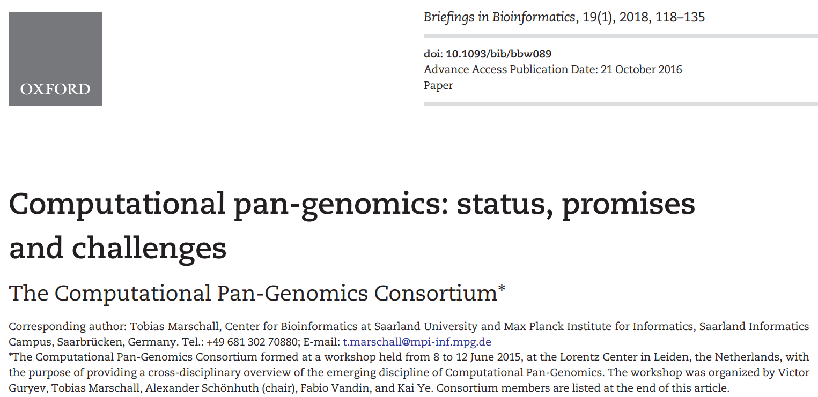
Expanding the Definition
Haploid genome assemblies on a single individual effective for the detection of SNVs and indels
Limited in ability to capture structural variation
Imputation of structural variation from SNP data has poor performance (https://bmcgenomics.biomedcentral.com/articles/10.1186/s12864-020-6627-8)
Pan-genomes can capture more complex (structural) variation
Data structures (i.e. genome graphs) have the potential to store haplotypes
Potential to be combined with statistical phasing methods for a more holistic view of haplotype diversity at the population level

Slide 27
Enabling Platforms
Binning
Trio binning (https://www.nature.com/articles/nbt.4277) – uses sequencing of trios to producing two reference-quality haplotypes from a single individual
Gamete binning (https://www.biorxiv.org/content/10.1101/2020.04.24.060046v4) – single-cell sequencing of hundreds of haploid gamete genomes to separate conventional long sequencing reads into two haplotype-specific read sets.
Population scale sequencing methods (https://onlinelibrary.wiley.com/doi/full/10.1111/1755-0998.13192
Using the same sequencing efforts as used in standard resequencing studies, linked‐read sequencing can provide valuable phasing information

